Slide 1
Monitoring and evaluating technical assistance to key populations and HIV projects in Russia: Removing legal barriers and community systems strengthening
Mikhail Golichenko & Richard Elliott
Canadian HIV/AIDS Legal Network
AIDS 2018, Amsterdam, 26 July 2018
Oral Abstract THAD0303

Slide 2
Outline
Russia Program (Global Fund)
Technical Assistance Program
M&E Design
M&E Results
Discussion
Conclusions
Follow-up

Slide 3
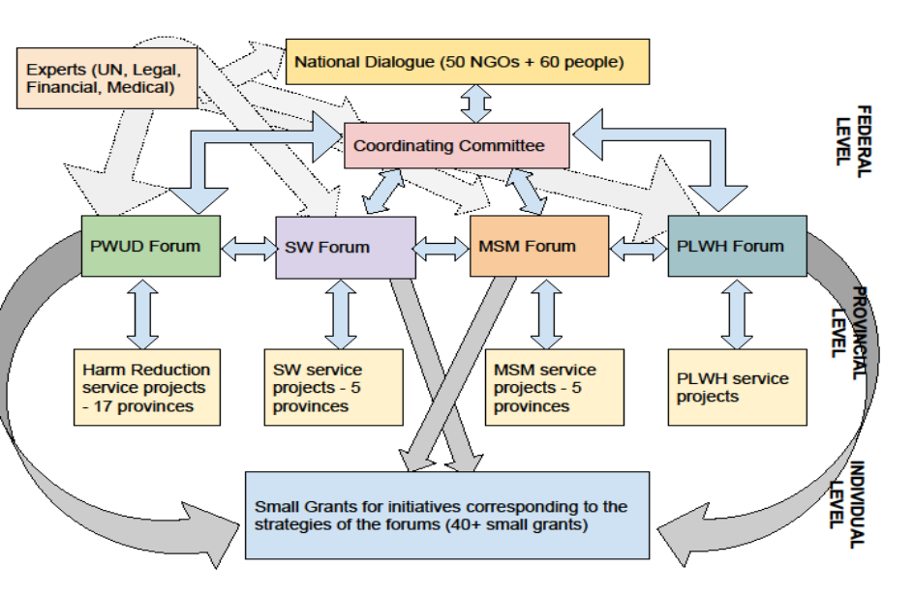
Russia Program: Global Fund 2014-2018
Notes:
3 components – GF grant (started June 2015 and extended to June 2018) - service component – an advocacy component in itself, given based on international recommendations – but not at scale
CSS
RLB / HRs (advocacy component)
3 levels to structure of GF program:
national
provincial
individual – small groups of KPs receiving small grants
Small grants:
Each service project will have a CSS and RLB component within it
But not everything is covered – so the forums for various KPs decide strategies to be pursued and so for some of those activities the small grants initiative is available for local work (approx USD 5-10K)
Main objective: include CSS/RLB components into GF programme based on Russian context and existing services from 2004 until 2014, developed with support from GF and other donors
3 KPs (per national dialogue May 2014, with election of Community Coordinating Committee): PWUD, SW, MSM (and PLHIV within those)
2 goals of advocacy component:
1) improve capacity f KP to partner with each other to engage government
2) improve KP capacity to use legal tools to enter into and maintain meaningful dialogue with government
“Experts” contributing at multiple levels – e.g. UNAIDS premises for CC meetings, legal TA expertise (MG/LN), WHO medical/health needs assessment, UNDP LEA, ministry costing expertise
Coordinating Committee continues to exist, beyond end of GF grant, to ensure coordination by/among KPs for services, advocacy
Some services continuing with other donor support
Q: Russian govt support for services?
see report
approx 40 projects getting some Russian govt $ (including some projects that were getting GF money)
but limitations: only project funding, not core/operational; govt money not necessarily available for some evidence-based services needed; NSP getting some govt $ (e.g. in St P, Kazan, Perm) – but very small amounts, need to be discreet, much depends on local political situation

Slide 4
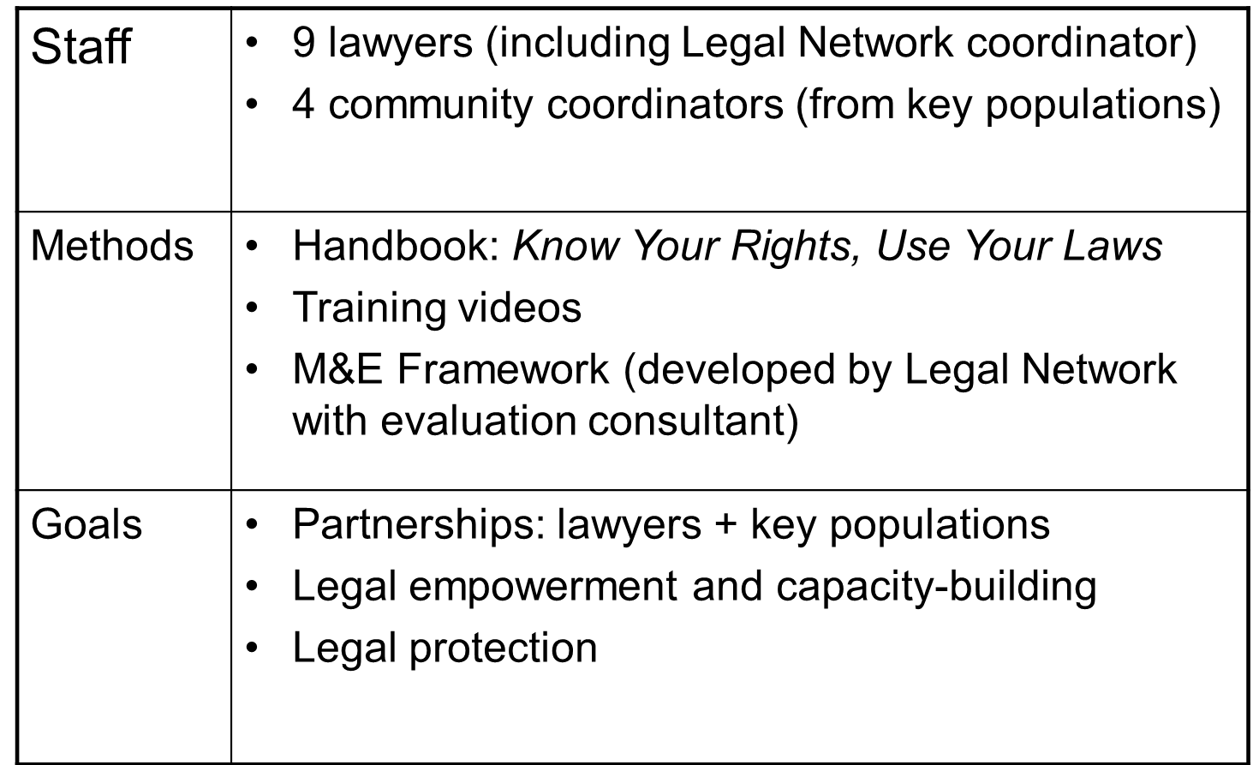
Technical Assistance Program (2016)
Notes:
GF TRP had excised the legal TA/support for advocacy components of the GF proposal
Fortunately, another donor supported this TA provision by LN – 1 year (but then extended)…. In year 2, GF took over paying for the lawyers, other funding supported CLW and related activities
M&E report only addresses year 1 of activities (Dec 2015 – Dec 2016)

Slide 5
Technical Assistance Know your rights, use your laws
Step 1 – Documentation of case
Step 2 – Develop strategic partnerships
Step 3 – Mediation or formal complaint
Step 4 – Follow up with authorities
Step 5 – National courts
Step 6 – Int’l human rights procedures
Step 7 – Implementation of decisions
Notes:
Step 1: Formal documentation of case has 3 components:
community contract
legal authorization to CLW to represent
Interview (5W, 1H format)
Step 2: Strategic partnerships
put together synopsis, with supporting documentation
ex: medical practitioner to document injuries, other service providers, lawyer if needed
Step 3: Mediation or formal complaint
unofficial target is 80% mediation to positive outcome, 20% complaint
Step 4 – following up
chasing substantive response
Step 5 & 6 – court proceedings if necessary (with varying degrees of assistance of lawyer)
Step 7 – Implementation of decisions
- pursuing official requests to authorities to respect/implement court decisions where feasible

Slide 6
Design of M&E
Quantitative indicators:
#of documented cases (target of 5% of clients in 1 year)
#of members of key populations who received CLW help
# of complaints filed seeking remedy/protection
#of state officials engaged
Qualitative indicators:
How do project street lawyers and key population representatives assess technical assistance?
interviews with technical assistance recipients
Has CLW practice changed as a result of legal technical assistance?
documented practices of TA providers

Slide 7
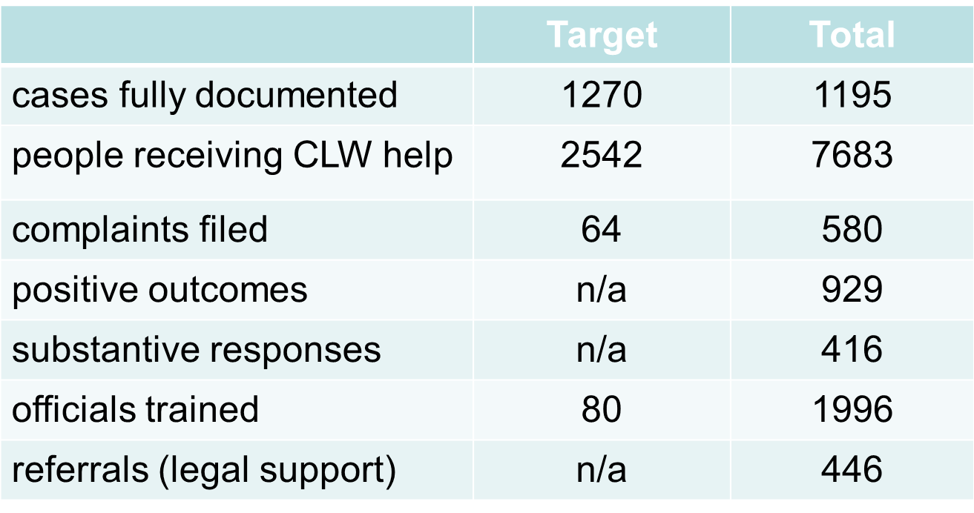
Quantitative indicators
Notes:
“cases documented”
- requires more rigorous algorithm for documenting in order to be counted as a “case”
# KPs receiving legal help:
- Q: target # higher than # of cases to be documented because… not full documentation in every case
high actual umber 7600+ heavily reflects problems of SW
Some “positive outcomes” achieved without any substantive response
Substantive response is one addressing (whether positive or negatively) substance of the complaint – either resolves issue or, if negative, a basis for pursuing further (e.g., with court proceeding)

Slide 8
Qualitative indicators: sources
31 of 86 organizations completed survey with quantitative and qualitative questions about:
Community Systems Strengthening & Removing Legal Barriers modules (of Global Fund grant)
accompanying technical assistance program
17 semi-structured key informant interviews

Slide 9
Survey and interviews
“The training sessions and ongoing communication with the TA team give the projects a strong emotional impulse, increasing their knowledge and intellectual potential.”
- Open Health Institute representative (principal recipient)
“The professionalism of our project staff has increased noticeably since the beginning of the project. They gained a better understanding of human rights and how we can help KPs protect their rights.”
– Project representative
“Thanks to this module [RLB] the project became more attractive for sex workers. We managed to gain their trust. Our RLB work guides the process of uniting the sex worker community.”
– Project representative

Slide 10
Most common issues
Sex workers | administrative offences & fines for sex work (Art. 6.11, Code of Administrative Offences) assault and robbery by clients humiliating treatment and unfounded detention by police
People who use drugs | humiliating treatment and unfounded detention by police administrative offences and fines (Article 6.9, Code of Administrative Offences) drug-related criminal offences (Article 228, Criminal Code) humiliating practices instead of evidence-based approaches in rehabilitation services refusal to remove a person from the drug treatment (“narcology”) registry after 3 years (in accordance with the new Health Ministry order)
ART & other health services | refusal to provide medical services (e.g., surgery) or HIV treatment to KPs ART interruptions or unexplained changes in treatment regimens limited or no access to treatment for domestic migrants (people moving from one city to another), labour migrants or immigrants
Common issues for different KP groups | termination of parental rights of people who use drugs, people living with HIV disability claims social support claims other legal issues related to property and finances

Slide 11
Challenges
Criminalization of key populations
Service provision paradigm vs. human rights advocacy
a false dichotomy
different approaches, challenges for M&E
Human rights TA also strengthened GF program through incorporation of HRs and (some) relevant indicators into performance framework
Short time-frame for M&E
Notes:
Criminalization of KPs
- Main challenge is marginalization, of which criminalization a major driver
KP feeling threatened if working to defend HRs; concern re risk
Some disappear, some stop acting after receiving some positive outcomes (e.g., PWUD framed by police, receives conditional sentencing and settles for this)
Service vs. human rights → INDICATORS
GF paradigm focussed on indicators re services … delivery, access/uptake
Human rights … more challenging to measure, poor cousin to service delivery
Achievement in itself that the GF-supported program in Russia finally agreed to include HRs indicators into their performance evaluation framework; the legal/HRs TA was of benefit not just on its own, but helped strengthen the GF program by compelling attention to HRs/advocacy dimension, including in indicators
Time-frame
Just 1 year for activities, challenge to show impact, particularly with qualitative measures of impact

Slide 12
Conclusions
Members of key populations can be effective human rights advocates, including using legal/quasi-legal mechanisms to defend rights, with TA
TA must be accessible 24/7, within an understandable framework, with clear indicators (qualitative & quantitative) for M&E
Legal component facilitates access to services, quality of services, and the continuum of care

Slide 13
Building on success
“Human rights support for better health outcomes: Facilitating the continuum of HIV treatment and care for people who use drugs in Saint Petersburg, Russia” (2017-2019)
Partnership between Legal Network and Humanitarian Action
Funding: Elton John AIDS Foundation (UK)
Notes:
Building on previous GF+TA project, this time trying to measure link between provision of CLW support and actual impact on continuum of care
EJAF giving $6M USD to Russia (out of EECA portfolio) over 3 years; many of these projects will need legal TA, several NGOs likely to identify LN as preferred partner for source of this
LN may seek USD 300K over 3 years from EJAF – but will need to secure co-funding as well

Slide 14
Acknowledgments All 400+ project CLWs, volunteers and lawyers Asya Bidordinova Laura Roper, Roper LYV Consultants Shona Schonning Project funder Global Fund to fight AIDS, Tuberculosis & Malaria Open Health Institute, Moscow

Slide 15
More information: Mikhail Golichenko mgolichenko@aidslaw.ca mgolichenko@gmail.com Full M&E report available (in English) via: www.aidslaw.ca/russia

